Slide 1
FUNDING YOUR COLLEGE EDUCATION
PUTTING THE PIECES TOGETHER
Notes:
Welcome the attendees and introduce HCC staff members who are co-presenting. Let attendees know that a copy of the presentation is in their folder, as well as additional information which you may refer to during the presentation. Also note that an evaluation form is included in the folder and that we would appreciate it if they take the time to complete it.
You may want to ask how many seniors and juniors (students and/or parents) are in attendance so that you can tailor the presentation to both, if need be.

Slide 2
COST
YOUR EFC
NEED
LOANS
FAFSA
SCHOLARSHIPS
DEBT
DEGREES
LOCATION
FINANCIAL AID
Notes:
There are many pieces to the college preparation puzzle, including deciding on a major, the type of institution you want to attend and how to finance your education. Our goal today is to assist you in understanding the financial piece, specifically how financial aid works. We hope at the end of the presentation you’ll walk away with a basic understanding of the financial aid application process and the types of financial aid that are available.

Slide 3
THE COST OF COLLEGE
Varies from school to school—community colleges, public universities, private colleges
The COA (Cost of Attendance) includes
Tuition and fees
Books and supplies
Room and board
Transportation costs
Personal expenses
Other Expenses
Notes:
The Cost of Attendance is likely one of the most important, if not the most important factor in choosing a college.
The Cost of Attendance varies from school to school because each differs in the amount of money required to attend. Community Colleges are much less expensive to attend than public universities and public universities are generally less expensive than private colleges.
Because of the differences in price, each college will have a unique Cost of Attendance (COA). The Cost of Attendance will include:
Tuition and fees
Books and supplies
Room and Board
Transportation costs
Personal expenses
Other expenses
The Cost of Attendance is important in determining how much financial aid a student will receive at each institution.

Slide 4
COMPLETE THE FAFSA
A MUST for most types of financial aid
FAFSA on the Web available January 1
March 1 is deadline for MD state aid
Many schools have February deadlines
www.fafsa.gov
Notes:
To be considered for most types of financial aid, a student must complete the FAFSA, which stands for the Free Application for Federal Student Aid. The FAFSA can be filled out online at fafsa.gov. and becomes available each year beginning on January 1st.
If you’re planning to attend HCC, you may apply for the FAFSA at any time during the year, but for best consideration and to meet the Maryland State Scholarship deadline, you should apply by March 1st each year.
If you plan to attend a college other than HCC, you will want to check the deadline dates at your selected institutions as many schools have February deadlines.

Slide 5
FAFSA HELP IS AVAILABLE
1-800-4FEDAID
YOU CAN AFFORD COLLEGE
FEBRUARY 13, 2016 AT HCC
THE COLLEGE YOU WILL ATTEND
FATV AT HCC
http://harford.financialaidtv.com/#playlist-37016:video-0
Notes:
Should you need assistance when completing the FAFSA, you may choose any of the following sources listed on the screen.
**FATV is a relatively new web portal where you can choose from a host of financial aid topics which are presented in short video clips. We highly recommend you become familiar with this as you may access information 24/7.

Slide 6
YOUR FSA ID
THIS IS YOUR LOGIN INFORMATION NEEDED TO ACCESS YOUR FA APPLICATION AND INFORMATION
FATV AT HCC
http://harford.financialaidtv.com/#playlist-39266:video-0
DIRECTIONS IN YOUR FOLDER
Notes:
Prior to completing the FAFSA you will want to develop a FSA ID which can be completed at fafsa.gov. The FSA ID acts as your signature when completing your FAFSA online and will provide access to various Department of Education websites.
Use the FATV video listed on the screen to view directions on how to develop an FSA ID.
**If you completed the FAFSA in previous years you would have used the FAFSA PIN number. Beginning with the current year, we now use FSA ID’s. The PIN number will no longer be accepted.
Directions for developing the FSA ID are included in your folder.

Slide 7
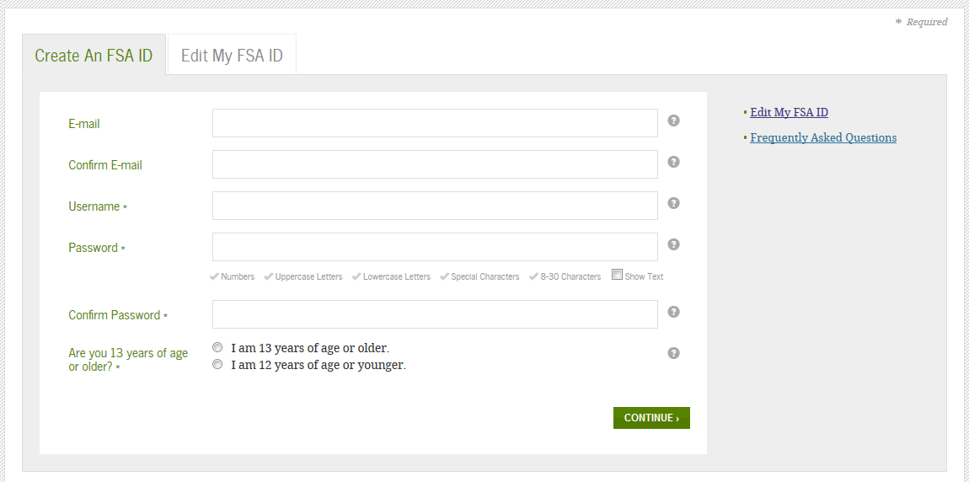
Notes:
To create your FSA ID, go to fafsa.gov and select the FSA ID icon, which is located toward the top of the page. When you click on the icon it will direct you to the page, shown on this screen, where you will create your ID.

Slide 8
COMPLETE THE FAFSA
www.fafsa.gov
If you need to complete the FAFSA before you have completed your 2015 tax return, then estimate your income to the best of your ability, but be sure to meet your college’s deadline
Use the FOTW worksheet to help you available on the FAFSA website
Notes:
Once the FSA ID has been developed you may complete the FAFSA. Go to fafsa.gov to complete the online form. If you haven’t completed your 2015 tax return, you may temporarily estimate your income in order to meet your college’s deadline. Once your 2015 taxes are completed, you will need to return to the FAFSA to add the correct information.
A video providing step by step directions for completing the FAFSA can be found at FATV.
Again, college deadlines vary so be sure to check with your selected college(s) to find out when financial aid information is due.
If you are a Maryland resident and plan to attend HCC, complete the FAFSA by March 1st to be considered for MD state aid as well as Federal aid.

Slide 9
THE FAFSA
The FAFSA formula determines your Expected Family Contribution (EFC)
Looks at parent and student income, assets, family size and number in college
The EFC is the amount of money the Department of Education has calculated that your family can afford to contribute to your education
Notes:
Once your FAFSA is submitted, you will receive an email from the Department of Education with a number representing the Expected Family Contribution (EFC). The EFC represents the calculated amount of money that your family can afford to contribute to your education as determined by the Department of Education. The EFC helps colleges determine how much financial aid a student may receive at their institution.
The student and parent income, assets, family size and number in college are used to calculate the EFC. Both the Cost of Attendance and EFC are used to determine a student’s eligibility for financial aid.

Slide 10
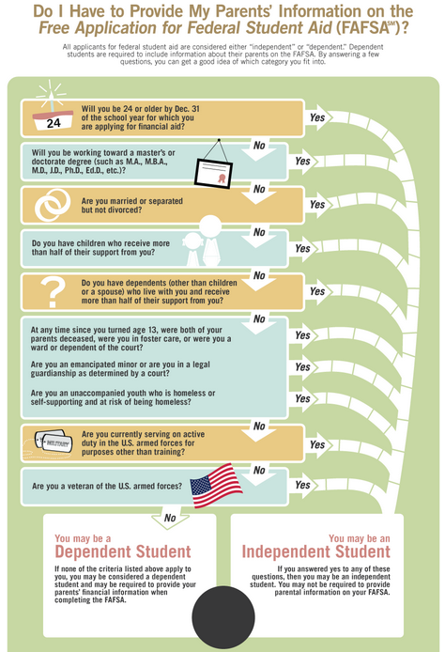
If all responses are NO, the student is dependent
Dependent students must include parent information
Notes:
As you complete the FAFSA, you will be asked questions to determine if the student is a dependent student or an independent student.
This flow chart, which is in your folder, will help you determine if a student is dependent or independent. If the student answers no to all of the questions then they are a dependent student. Dependent students must include their parent’s information even if they don’t live in their parent’s household.

Slide 11
PARENT INFORMATION
Dependent students MUST include parent information
Tax, income, and other financial information
Dislocated worker status
Receipt of federal means-tested benefits
Assets
Untaxed income
Notes:
Dependent students must provide their parent’s information including:
Tax, income, and other financial information
Dislocated worker status
Receipt of federal means-tested benefits
Assets
Untaxed income
If your parents are divorced or separated, you will use the parent’s income with whom you live with more than 50% of the year. If the parent you live with is remarried you will need to include your step-parent’s information as well.
Leaving out or misrepresenting information will likely slow down the processing of your financial aid, so please be as accurate as possible.
Please note, some private colleges will require you to provide additional financial information on a form called the CSS Profile. About 300 private colleges are using this form to determine eligibility for need based institutional aid.

Slide 12
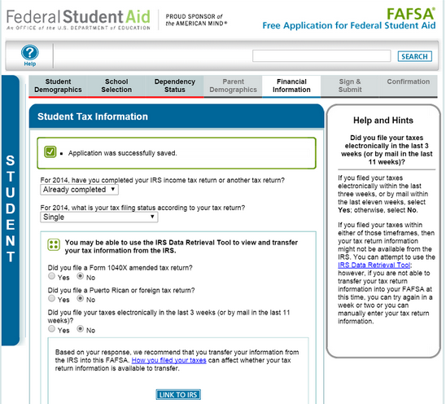
IRS DATA RETRIEVAL
USE THE IRS DATA RETRIEVAL
Notes:
Using the IRS Data Retrieval tool when completing the FAFSA will make the process less time consuming because the IRS will transfer tax information directly onto the FAFSA for you. This will also eliminate the need to order an IRS Tax Transcript, a requirement for many students whose information needs to be verified.

Slide 13
STUDENT (AND SPOUSE) INFORMATION
Tax, income, and other financial information
Dislocated worker status
Receipt of federal means-tested benefits
Assets
Untaxed income
Notes:
During the FAFSA application process, the student and, if married, their spouse will be asked to provide the following information:
Tax, income and other financial information
Dislocated worker status
Receipt of federal means-tested benefits
Assets
Untaxed Income
If you’re unsure of what the form is asking for, there is a helpful hints box to the right of each question which will explain in more detail what is being requested.

Slide 14
PARENT INFORMATION
Parent marital status
Include both parents if married or live together
Include step parent if your parent remarried
Tax, income, and other financial information
Dislocated worker status
Receipt of federal means-tested benefits
Assets
Untaxed income
Notes:
Dependent students will need to provide their parents information, including:
Parent marital status - include both parents if they are married or live together
- include your step parent if the parent you live with is remarried
Parents tax, income and other financial information
Dislocated worker status
Receipt of federal means-tested benefits
Assets
Untaxed income

Slide 15
COMMON FAFSA ERRORS
SSN Errors
Divorced/remarried parental information
Income earned by parents/stepparents
Untaxed income
US income taxes paid
Household size
Number of family members in college
Real estate and investments net worth
Notes:
You want to be very careful when completing the FAFSA, but sometimes errors occur. Some common errors are listed here. Errors can cause the process to take much longer, so accuracy is key.

Slide 16
SIGNATURES
Required
Student
One parent (dependent students)
Format for submitting signatures
Electronic using FSA ID
Signature page printed from online FAFSA
Paper FAFSA
Notes:
Signatures are required when submitting your FAFSA. When completing the FAFSA online you will use your FSA ID as your signature. If you’re dependent your parent must also sign with their own FSA ID.
You may also choose to print the signature page from the online FAFSA, or complete a paper FAFSA, but either of these choices will take longer to process. It’s best to complete the FAFSA online and sign with the FSA ID, when possible.

Slide 17
WHAT IF YOU NEED TO CORRECT YOUR FAFSA INFORMATION?
Go to www.FAFSA.gov and use the FSA ID to correct the FAFSA online
Both parent and student will have to “sign” the corrections using the FSA ID
Notes:
If an error has been made on your FAFSA you may return to the online application to make corrections. Go back to FAFSA.gov, make the correction, then be sure to sign the corrected FAFSA using your FSA ID. Make sure the parent signs with their FSA ID as well, if the student is dependent.

Slide 18
WHAT’S NEXT?
FAFSA processing results sent to student by paper or email—Your EFC will be included
Your information is sent to the schools you listed on your FAFSA
If you need to send your school additional documents, they will notify you by mail or email
Notes:
Once the FAFSA is submitted you will receive an email from the Department of Education indicating that it’s been received. Your EFC will be included.
Your information will also be sent to the schools you listed on your FAFSA. Once received by the schools, you will either receive communication that additional information is needed or you will receive an award notification.
If you receive communication that additional information is being requested, you will need to submit the information before your award can be processed. Please make sure to respond as quickly as possible to any requests.

Slide 19
YOUR NEED
COA – EFC = NEED
Your EFC will remain the same, but your COA and your NEED vary from school to school
Your financial aid packages will also vary from school to school
Notes:
Once a student’s FAFSA is received at their selected college(s), each college will take their Cost of Attendance minus the student’s Expected Family Contribution to determine the amount of aid the student is eligible for at that specific institution.
Since each college has a unique Cost of Attendance and each student has a unique Expected Family Contribution, the amount of aid received at each institution will vary from school to school and student to student.

Slide 20
Cost of Attendance Comparison
 | HCC | UMCP | Towson | Frostburg | Stevenson | Hopkins | Loyola
T&F | 3300 | 9996 | 9182 | 8488 | 31009 | 49210 | 45200
R&B | 0 | 10972 | 11306 | 9878 | 12490 | 14540 | 13310
B&S | 1300 | 1130 | 1080 | 1300 | 1250 | 1210 | 1240
TRAN | 1546 |  | 1600 | 750 | 600
MISC | 1000 | 2490 | 1500 | 1000 | 1000 | 1686 | 1200
TOTAL | 7146 | 25,588 | 24,668 | 21,416 | 47,149 | 66,646 | 60,950
Notes:
Here’s a cost of attendance comparison between several local colleges. As you can see the costs vary significantly.

Slide 21
TYPICAL AID PACKAGES
 | HCC | TOWSON | STEVENSON
COA | 7,146 | 24,668 | 47,149
EFC | 0 | 0 | 0
GROSS NEED | 7,146 | 24,688 | 47,149
FED GRANTS | 6,800 | 6,800 | 6,800
SCHOLARSHIPS | 0 | 500 | 10,000
LOANS | 346 | 5,500 | 5,500
PARENT LOANS | 0 | 11,888 | 24,848
UNMET NEED | 0 | 0 | 0
Notes:
Let’s look at some typical aid packages. When we compare three Maryland colleges; HCC, a 2-yr community college, Towson University, a public four-year college, and Stevenson University, a private four-year institution, you can see that the Cost of Attendance varies significantly. What doesn’t change is the Expected Family Contribution. Because the Cost of Attendance is different for each, the gross need from institution to institution will vary greatly.
Once the gross need is calculated, by taking the Cost of Attendance minus the Expected Family Contribution, the financial aid award can be determined. As you can see from this chart, the student would receive the same amount in Federal Grants at each institution. Scholarship awards would vary as would the amount of loan money they would receive.
When determining what awards to give a student, the federal grants are given first, followed by scholarships, then loans. Each school will give the maximum amount of free money the student is eligible for, including grants and scholarships, before offering loans.
In all three cases, there is no unmet need left once the award packages have been determined, but the types of aid differ because of costs. When attending four year institutions a good bit of the aid package will likely include loans.

Slide 22
FEDERAL AID PROGRAMS
FEDERAL PELL GRANT
1516 MAX GRANT IS $5,775 for 0 EFC
Must do FAFSA each year
Amount varies with EFC and the number of credits for each semester
Federal SEOG (Supplemental Educational Opportunity Grant)
Must do FAFSA each year
Max amount is $4,000 per year
Notes:
(next presenter begins here)
Now that we’ve discussed how financial aid eligibility is determined, let’s take a look at the types of aid programs that are available. Three sources of financial aid which we’ll discuss are federal aid, state aid and other aid.
The Federal Aid Programs include the Federal PELL Grant and the Federal Supplemental Education Opportunity Grant or FSEOG. To be eligible for these grants you must complete the FAFSA each year. The amounts available for these grants vary from year to year.
For example, this year a student with a “0” EFC is eligible for the maximum PELL Grant of $5775 if they are enrolled full-time. If the student is less than full-time, the grant is adjusted according to the number of credits they are taking.
The Federal SEOG is for students who demonstrate high need and are PELL eligible. The maximum amount for this grant is currently $4,000 per year

Slide 23
TEACH Grants
Must be enrolled in a teacher ed program
$4,000 per year
Must agree to teach in a Title I school
Becomes an unsub loan if you do not meet the requirements after graduation
Iraq and Afghanistan Service Grant
Not eligible for Pell based on EFC, but meet all other requirements
Parent was a member of the US armed forces and died as a result of military service performed in Iraq or Afghanistan
Notes:
Additional federal grants include the TEACH Grant and the Iraq and Afghanistan Service Grant.
We do not offer the TEACH Grant at HCC however many other institutions do. When accepting this grant you must agree to teach in a Title I school for a predetermined number of years. If you do not complete your program, or choose not to teach in a Title I school, your grant turns into an unsubsidized loan, AND the interest will be calculated back to the time the grant was initiated. Please use caution when seeking this grant.
To be eligible for the Iraq and Afghanistan Service Grant you do not have to be PELL eligible, but your parent had to be a member of the US armed forces and died as a result of military service performed in Iraq or Afghanistan.

Slide 24
FEDERAL WORK STUDY
Provides part-time employment while in school
Must complete the FAFSA and have unmet need
Can work on campus or off campus in community service jobs
Notes:
Federal Work Study provides students with part-time employment while in school. You must apply for FAFSA and show unmet need to be eligible for this program. Students may choose to work on campus, or off campus in community service jobs.
A couple of advantages to this program are student’s receive a pay check every two weeks for hours worked, and they build a work history for their resume.

Slide 25
FEDERAL STUDENT LOANS
Direct Subsidized Loans—made to undergrad students who have need
Direct Unsubsidized Loans—made to students who do not have a financial need
Direct PLUS Loans—made to parents of dependent undergrad students to help pay for educational expenses not covered by other aid
Notes:
Federal Direct Student Loans are available to assist with college costs as well. Since students must pay back loans with interest, this is generally the last source added to the financial aid package.
To be eligible for Direct Loans from the Federal government students must complete the FAFSA. There are two types of federal loans for students, Direct Subsidized and Direct Unsubsidized.
To be eligible for a Direct Subsidized Loan a student must show financial need on their FAFSA. Direct Unsubsidized Loans can be made to students who do not show financial need.
A third type of Direct Loan called the Direct PLUS Loan is available to parents of dependent undergraduate students. This loan is made available to parents to help pay for educational expenses not covered by other aid.

Slide 26
FEDERAL STUDENT LOANS
Year | Dependent Students (except students whose parents are unable to obtain PLUS Loans) | Independent Students (and dependent undergraduate students whose parents are unable to obtain PLUS Loans)
First-Year Undergraduate Annual Loan Limit | $5,500—No more than $3,500 of this amount may be in subsidized loans. | $9,500—No more than $3,500 of this amount may be in subsidized loans.
Second-Year Undergraduate Annual Loan Limit | $6,500—No more than $4,500 of this amount may be in subsidized loans. | $10,500—No more than $4,500 of this amount may be in subsidized loans.
Third-Year and Beyond Undergraduate Annual Loan Limit | $7,500—No more than $5,500 of this amount may be in subsidized loans. | $12,500—No more than $5,500 of this amount may be in subsidized loans.
Graduate or Professional Students Annual Loan Limit | Not Applicable (all graduate and professional students are considered independent) | $20,500 (unsubsidized only)
Subsidized and Unsubsidized Aggregate Loan Limit | $31,000—No more than $23,000 of this amount may be in subsidized loans. | $57,500 for undergraduates—No more than $23,000 of this amount may be in subsidized loans. $138,500 for graduate or professional students—No more than $65,500 of this amount may be in subsidized loans. The graduate aggregate limit includes all federal loans received for undergraduate study.
Notes:
This chart breaks down the loans by year in college. As you look across the top line you see that a first year dependent student, with 30 or less credits earned, would be eligible for a maximum of $5500 in Direct Loans. $3500 would be the maximum allotted for Subsidized Loans. The exact amount would be determined by their EFC and other awarded aid. Any additional loan money, up to the maximum $5500 would be awarded as an Unsubsidized Loan.
Independent first- year students with 30 or less credits earned would be able to borrow a maximum of $9500 of which $3500 would be the maximum in Subsidized Loans.

Slide 27
INTEREST RATES (right now)
Loan Type | Borrower Type | Loans first disbursed on or after 7/1/15 and before 7/1/16
Direct Subsidized Loans | Undergraduate | 4.29%
Direct Unsubsidized Loans | Undergraduate | 4.29%
Direct Unsubsidized Loans | Graduate or Professional | 5.84%
Direct PLUS Loans | Parents of dependent undergrads | 6.84%
Notes:
When you borrow a Direct Loan you must pay it back with interest. The current rates are listed on this chart. Rates vary from year to year.
While the Direct Subsidized and Direct Unsubsidized loans have the same interest rate, currently 4.29%, there is an advantage to having a Subsidized loan. You will not pay interest on your Subsidized Loan while attending college if you are enrolled in at least six credits per semester. This can save a you great deal of money in interest over the lifetime of your loan. Again, the FAFSA determines your eligibility for a Subsidized Loan, which is why it is so important to apply even if you don’t think you’ll be eligible for other types of aid.
Also, while enrolled in at least six credits, you will not have to pay the principle on an Unsubsidized Direct Loan, however, the interest will accrue while your in school. Paying the interest while in school will help keep added costs to a minimum.

Slide 28
FEDERAL STUDENT AID
https://studentaid.ed.gov/sa/ for information on all federal student aid programs
Notes:
To obtain more information about the Federal Student Aid Programs visit studentaid.ed.gov

Slide 29
MARYLAND STATE AID PROGRAMS
Need-Based Grants (Require FT attendance)
Guaranteed Access Grant for current MD high school seniors who are high need students
Awards up to $16,100 per year depending on school attending (must live in Maryland)
Educational Assistance Grants available to Maryland students with need
Awards up to $3,000 per year
Maryland Part-Time Grant available to PT Maryland students with need
Awards up to $2,000 per year
Notes:
In addition to the Federal Aid programs, there are Maryland State Aid programs. The Maryland State need-based grants include the Guaranteed Access Grant or GAG, the Educational Assistance Grant and the Maryland Part-time Grant. A student’s eligiblity for these programs is determined by your FAFSA results.
The Guaranteed Access Grant is for current Maryland high school seniors who demonstrate high financial need. Awards are given for as much as $16,100 per year depending on the Maryland college the student is attending.
The Educational Assistance Grant is available to Maryland student who demonstrate need. Awards are provided at a maximum of $3000/yr.
The Maryland Part-time Grant is available to students taking six to 11 credits per semester. The maximum award per year is $2000.

Slide 30
MARYLAND STATE PROGRAMS
Legislative Scholarships
Delegate—awards begin at $200
Senatorial—awards range from $400 to $10,100
Made by your Senator or Delegate
Contact your representative for application information
Notes:
Additional Maryland State Programs include Legislative and Senatorial Scholarships. While you do want to complete the FAFSA to be considered for these programs, you’ll also need to contact your Senator or Delegate for specific application information. Additional details can be located at the Maryland Higher Education Commission website at mhec.md.gov

Slide 31
MARYLAND CAREER/OCCUPATION-BASED GRANTS
Workforce Shortage Student Assistance Grant Program
For students in specific career programs
Charles Riley Firefighter and Ambulance and Rescue Squad Member Scholarship Program
For students actively engaged in these careers
Notes:
The state of Maryland also offers Career or Occupation-based grants.
The workforce shortage student assistance grant program is available to aid students in specific career programs. Eligible majors and employment fields are determined annually so check the Maryland Higher Education Commissions web page for additional information.
The Charles Riley Firefighter and Ambulance and Rescue Squad Member Scholarship Program is available to students actively engaged in these fields.

Slide 32
MARYLAND UNIQUE PROGRAMS
Tolbert Grant—for students attending private career schools
Conroy Scholarship—for dependents of deceased or disabled military persons, victims of 9/11 attack, POW or MIA of the Vietnam Conflict, state or local public safety employee or school official who died or became disabled as a result of the attack
Notes:
There are a couple of unique Maryland grant programs as well which include the Tolbert Grant and Conroy Scholarship. A brief overview is listed here, but since these are unique, it is best to visit the Maryland Higher Education Commission web site for details.

Slide 33
VETERANS OF AFGHANISTAN AND IRAQ CONFLICTS SCHOLARSHIPS
Armed forces personnel, their spouses and children, may apply
Must be Maryland residents
Award amounts—maximums for 2015-2016
On Campus: | up to $6,669
With Parents: | up to $4,222
Off Campus: | up to $4,792
Notes:
The Veterans of Afghanistan and Iraq Conflicts Scholarship is available to armed forces personnel, their spouses and children. To apply you must be a Maryland resident. Maximum award amounts for 2015-2016 are listed here. For more details visit the MHEC website.

Slide 34
MARYLAND TUITION WAIVERS
Foster Care Recipients—full tuition and fee waiver at MD public colleges. Must be in an out of home placement at the time he or she graduated from HS, or have resided in an out of home placement as of their 13th birthday, or be a younger sibling of a child who meets the qualifications.
Notes:
There are also several types of Maryland tuition waivers. The first covers full tuition and fees for foster care recipients. The student must attend a Maryland public college to be eligible. Additional requirements are listed here and on the MHEC website.

Slide 35
MARYLAND TUITION WAIVERS
Tuition Waiver for Unaccompanied Homeless Youth—full tuition and fee waiver at MD public colleges
Must be declared as an unaccompanied homeless youth who is not in the physical custody of a parent or guardian AND
Be a homeless child or youth as defined by the McKinney-Vento Homeless Assistance Act
Notes:
Another Maryland tuition waiver is available for unaccompanied homeless youth. Again, this covers full tuition and fees at Maryland public colleges. Additional details may be found at the MHEC website.

Slide 36
MARYLAND TUITION WAIVERS
Maryland Army National Guard Tuition Waiver—provides an up front waiver of up to 50% for tuition cost for members of the MD Army National Guard attending MD colleges
Community College Tuition Waiver for Students with Disabilities
Must be receiving SSI or SSDI
Must complete the FAFSA
Notes:
The state of Maryland also offers a tuition waiver for members of the Maryland Army National Guard. This waiver provides an up front waiver of up to 50% of tuition costs for those members attending Maryland colleges.
And finally, there’s a Community College Tuition Waiver for students with disabilities. To be eligible the student must be receiving SSI or SSDI and have completed the FAFSA.

Slide 37
MARYLAND OFFICE OF STUDENT ASSISTANCE
http://www.mhec.state.md.us/financialAid/descriptions.asp
Complete information on all programs
Notes:
Again, visit the Maryland Office of Student Assistance website, also referred to as the Maryland Higher Education Commission website, at the link listed on the screen for additional details about the many programs available through the state of Maryland.

Slide 38
OTHER SOURCES OF AID
Churches, organizations, foundations, corporations
Colleges and universities
May be awarded for academic achievement, religious affiliation, ethnic/racial heritage, community activities, volunteerism, artistic talents, athletic ability, etc.
Notes:
There are many other sources of aid beyond federal and state programs. Many organizations, churches, foundations and corporations offer scholarships. College and universities have endowments available to assist students. Tapping into these resources often requires that you ask for information and complete additional applications, but taking the time to do so can mean the difference between graduating debt free and being highly indebted.
Scholarships are given for a host of reasons. A good portion are need-based, however, many are awarded based on special talents, community activism, volunteerism and academic achievement.

Slide 39
INTERNET SCHOLARSHIP SEARCHES
www.collegeboard.com/paying
www.fastweb.com
www.finaid.org
www.myscholly.com
Notes:
There are many great internet scholarship websites available. On this slide, we’ve listed several of our favorites. However, use caution when searching for scholarships. Beware of sites that request payment to apply. You should never have to pay to be considered for a legitimate scholarship.

Slide 40
FINANCIAL AID TV
Notes:
Financial Aid TV is a relatively new web portal available at HCC . You have a postcard in your folder that gives you the direct link to the portal. Financial Aid TV offers short videos related to a host of financial aid topics. The topics are listed in categories or playlists and are generally very brief. This information is especially helpful as you begin navigating the financial aid process. There’s even a step by step tutorial available to guide you through the FAFSA application process.

Slide 41
Notes:
Each year in February HCC’s financial aid office hosts an special event called “You Can Afford College”. The event is held in Joppa Hall on a Saturday from 9:00am- 1:00pm. This year the event will take place on February 13th . Financial aid specialists will be available to provide additional information, answer questions, and help you complete the FAFSA. Everyone is welcome regardless of what college they are attending.
That concludes tonight’s presentation. I hope we’ve provided you with a general understanding of the financial aid process. We are available to answer any questions you may have. Thank you for attending.

