Slide 1

College Application Presentation

Slide 2

Building your list of schools
What to consider:
  Location, finances, sports, etc.
  Career goals/Majors – Does this school have internships or programs for my field of interest?
  Admissions criteria
    Pay attention to deadlines, GPA, SAT/ACT scores, how many letters of rec. required, type of application, strength of schedule, 1st quarter report card, etc.
  Naviance is a fantastic resource but always double check with the college’s website

Slide 3
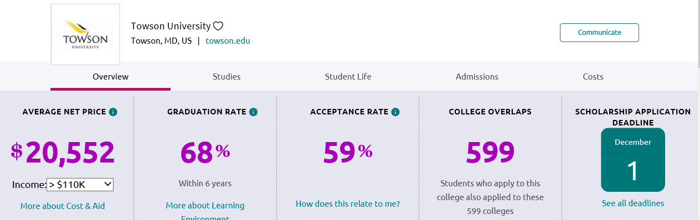
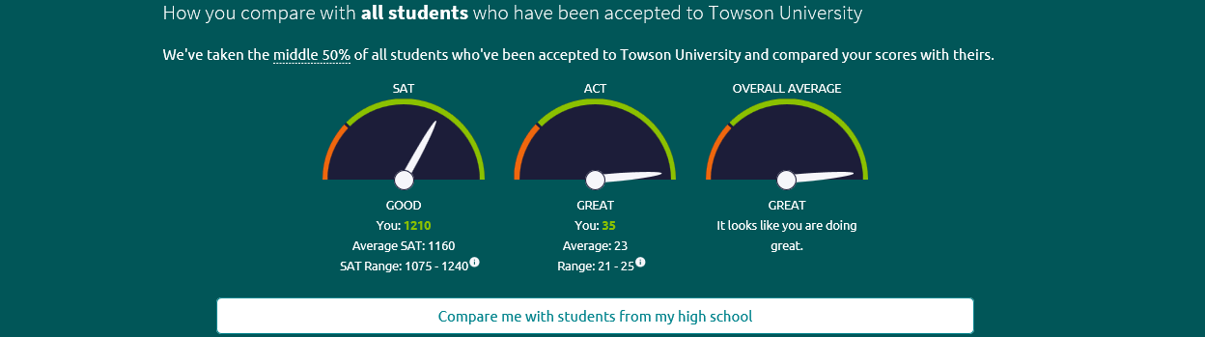
Refresher example – Towson University

Slide 4
Application Deadlines
Early Decision: Binding, only top choice
Early Action: Nonbinding, receive admission decision earlier
Priority: receive priority consideration in admission and financial aid awarding process
Regular: applications must be submitted by this date, not reviewed until after this date
Rolling: Long application window, colleges review applications as they arrive, decision within a few weeks

Slide 5
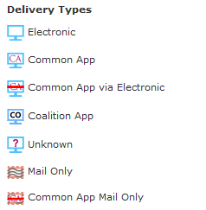
What is a Transcript?
A transcript is an official record of your school experience on paper
It includes:
  Your GPA
  Final grades in courses you have taken
  Class rank
  Attendance
Notes:
Mention that they need us to gain access to them.

Slide 6

Transcript procedures
  Before you request a transcript:
  Student and parent sign transcript release form/Naviance permission
  Waiving rights to view letters of rec: To waive, or not?
How should I request a transcript?
Colleges I’m applying to
Look for the “Request transcript” button
Select the schools you want to request transcripts for
Hit submit!
Notes:
Mention the credibility issue in regards to waiving rights to view.

Slide 7
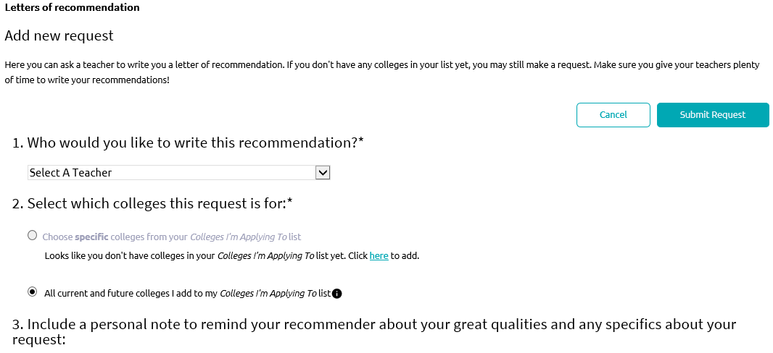

Letters of Recommendation
Complete the brag sheet on Naviance
Make sure to speak with teacher before you send a request
Send the teacher your request
Follow up with a written thank you note/email
Notes:
Mention how this is covered by their waiver for the letters of rec

Slide 8
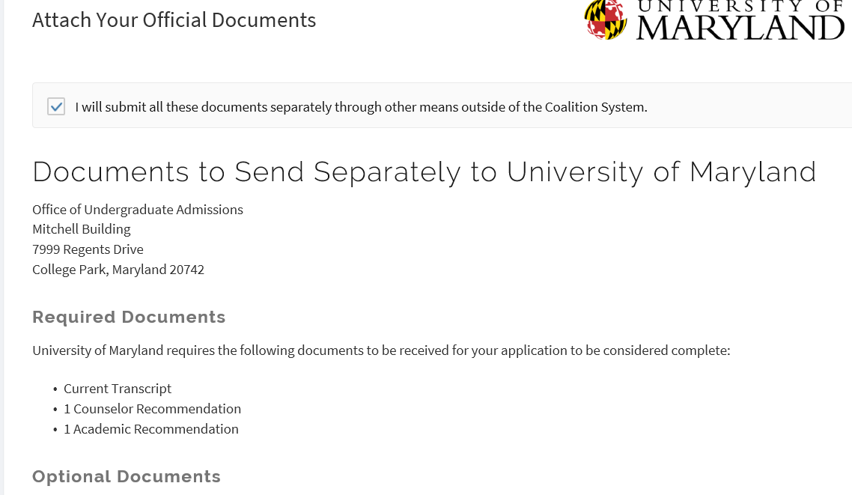
Common App Vs. Coalition App
The Common Application is an undergraduate college admission application that applicants may use to apply to any of 517 universities
The Common App and Naviance can be connected (view video on home page)
Notes:
Say out loud- YOU DO NOT NEED TO USE THE COMMON APP, but you can use it if saves you time or energy. Ask your counselor if you are unsure.
SAME THING WITH THE COALITION APP

Slide 9
Common App Account Matching
http://www.screencast.com/t/gxEQkElyo1

Slide 10

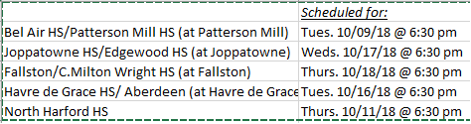
FAFSA & Scholarships
FAFSA: Free Application for Federal Student Aid
- Cost of Attending
- EFC: Estimated Family Contribution
- Federal Pell Grant = Financial Need
- Colleges use this information for scholarships
-Submit at fafsa.ed.gov
CHECK COLLEGE FINANCIAL AID DEADLINES
Where to find scholarships:
Naviance:
  Under the colleges tab
  Scholarships and Money
  Scholarship List
HCPS.org
Colleges you are applying to
Parent’s workplace
Local community organizations
Financial Aid Nights
Notes:
Explain how the tuition cost is not the total cost of attending
Explain how the financial aid basics work
Plug the financial aid seminar
Stress that we can help them- Money is a barrier to college that CAN almost always be overcome.

Slide 11
Colleges visiting CMW
Sign up for College visits through Naviance
You will receive an email notification for colleges on your list
Admission counselors will be available to meet with students during lunch
Important to make connection with school of choice
ASVAB Testing:
  Sign Up under College Visit Tab

Slide 12
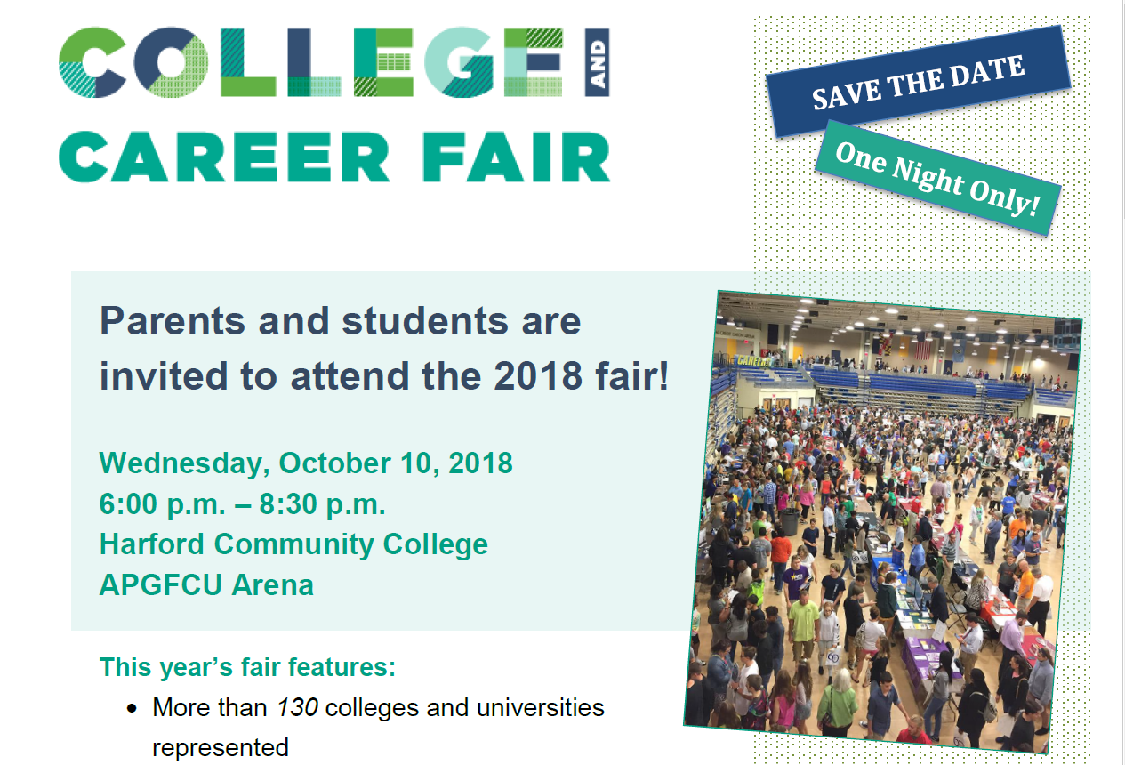
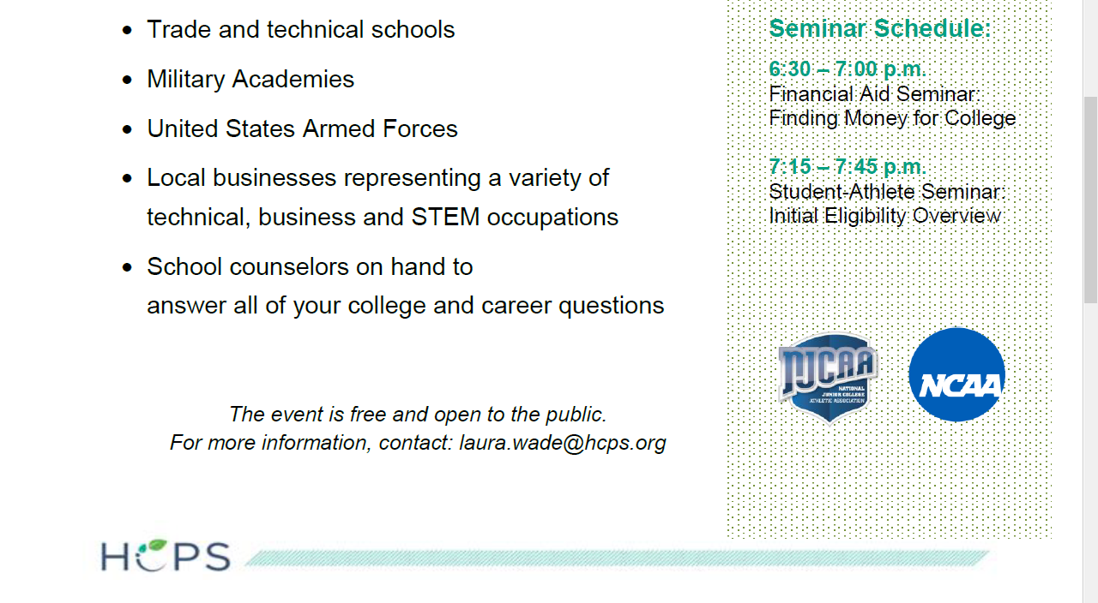

Slide 13
Senior to do List
Apply to Colleges (see college website)
If you are using the Common App, match your account in Naviance
List all of the colleges you are applying to under your Colleges I’m Applying To Tab
Indicate your current application status
    Applied, Accepted, etc.
    Via Common App or directly to the institution
Request Transcripts
Request Letters of Recommendation
  Complete Brag Sheet/Resume
Sign up for College Visits and Info. Sessions
Re-take the SAT/ACT if needed
Apply for scholarships
Notes:
Show students the list of what to do, explain that they are about to have a few minutes of supervised work time before we close out the lesson, tell them this is where they get caught up or go further on in the process.
Remind them that this list is in their packets

